Slide 1


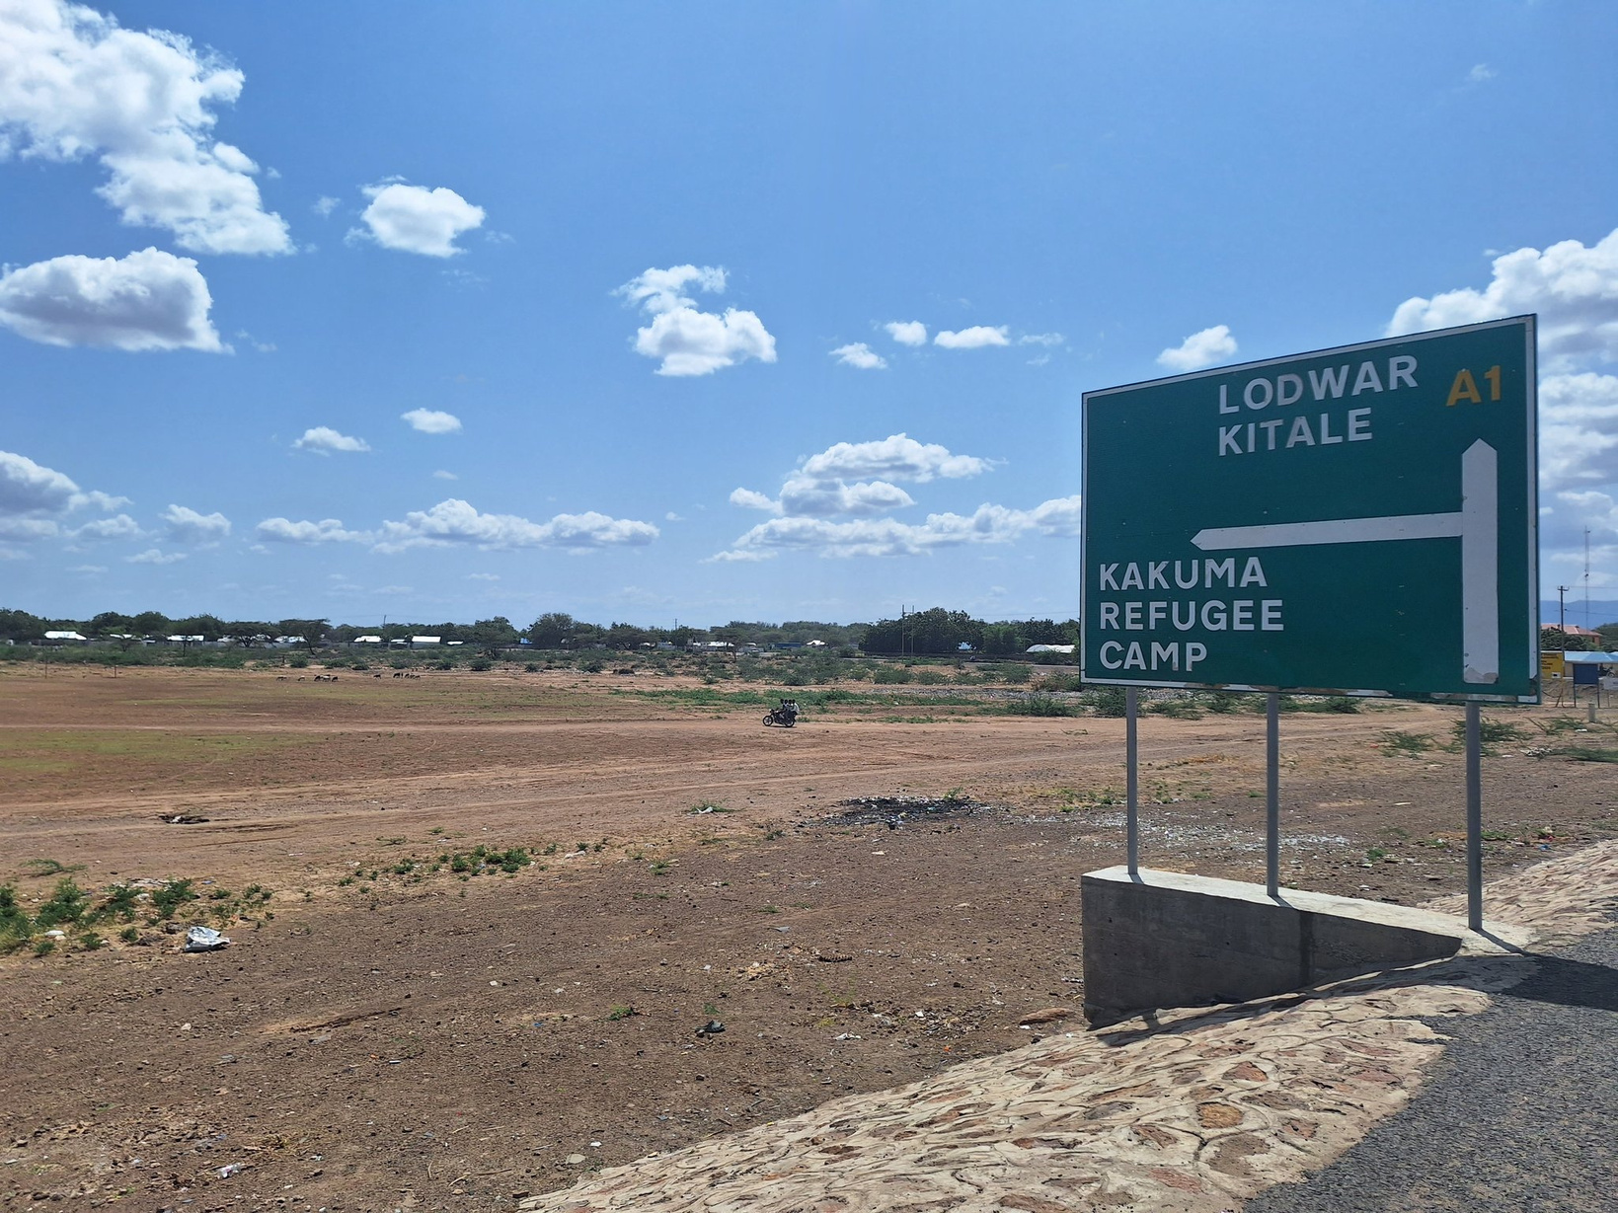

Advocating for refugee and human rights worldwide
LERRN Presentation
Understanding Socio-economic Barriers for Refugees in Kenya: Challenges with Registration and Documentation at Kakuma Refugee Camp
Presented by Rai Friedman
www.GlobalRightsDefenders.org
Notes:
Hello everyone,
My name is rai friedman and I am the founder & CEo of global rights defenders
Before we get into our presentation today I want to share my gratitude to the voice for rights international association for inviting us to be part of this incredible youth congress
I want to express my excitement to be back presenting at my alma matter UBC as I graduated from the school of public policy in 2020
Lastly, I want to say how proud and excited I am for all of the youth delegates here in the room today, I hope to see you n the field very soon
Although I am currently not in Vancouver, I was born and raised on the unceded territory of the musquem squamish and tseil wah tooth first nations. Thank you for sharing nyour land with me so I could have the chance to grow and proposer
That brings us to our presentiation – today I will be discussing the intersection of leadership and human rights

Slide 2
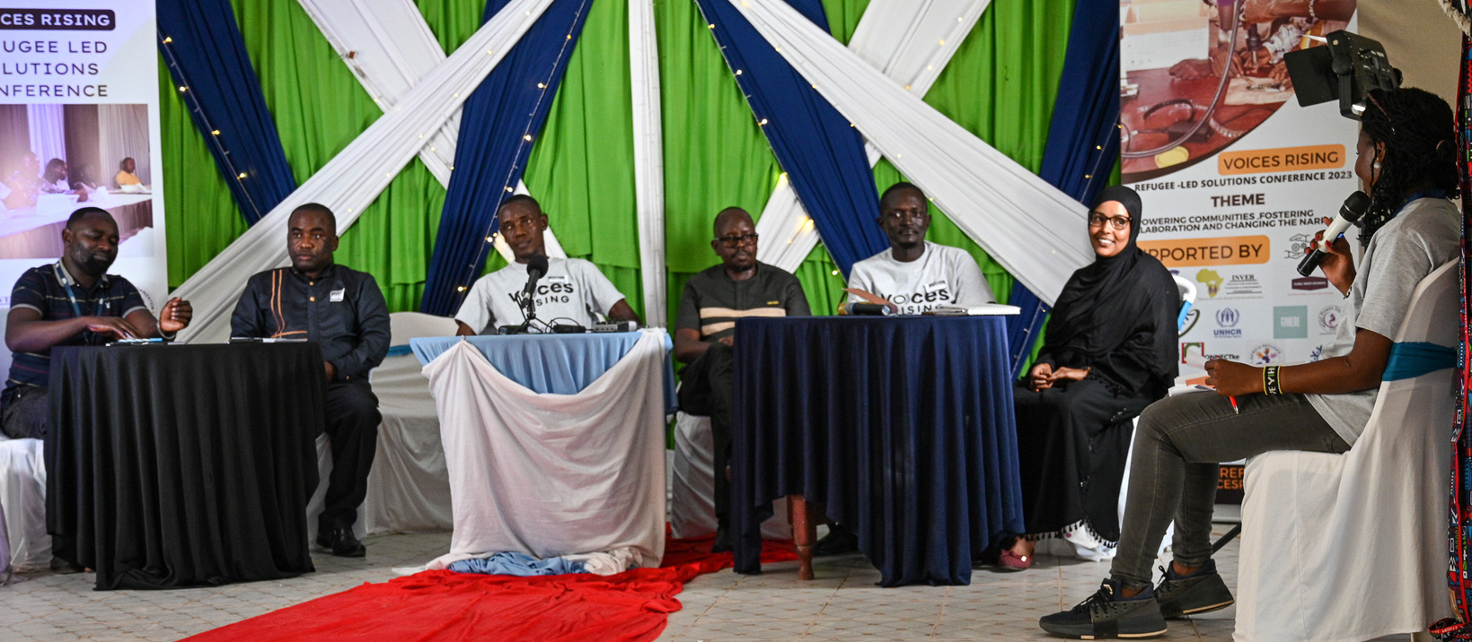




ABOUT
GLOBAL RIGHTS DEFENDERS
Migration
Governance
Self-Reliance
Capacity Sharing
Global Rights Defenders (GRD) is a Canadian non-profit which advocates for refugee and human rights worldwide. We do so through research, policy analysis & advocacy and community engagement.
Our work consists of working with individuals with lived experience of forced displacement, and campaigning for the promotion and protection of displaced persons rights. Our work is guided by international human rights and refugee law, and respect for the dignity of each human being.

Slide 3


MANDATE
to determine durable solutions to the global refugee crisis through strengthening migration governance measures as established in the Global Compact for Refugees.
to create an inclusive society for all, where displaced populations can be safely protected within host societies and be shielded from discriminatory practices as defined and prohibited in the 1951 Refugee Convention, and its 1967 Protocol
Mission
to empower displaced populations to achieve socio-economic independence and self-reliance, and to build their capacities to ensure that their rights, freedoms and dignities are being upheld and valued.
Vision
Goals

Slide 4
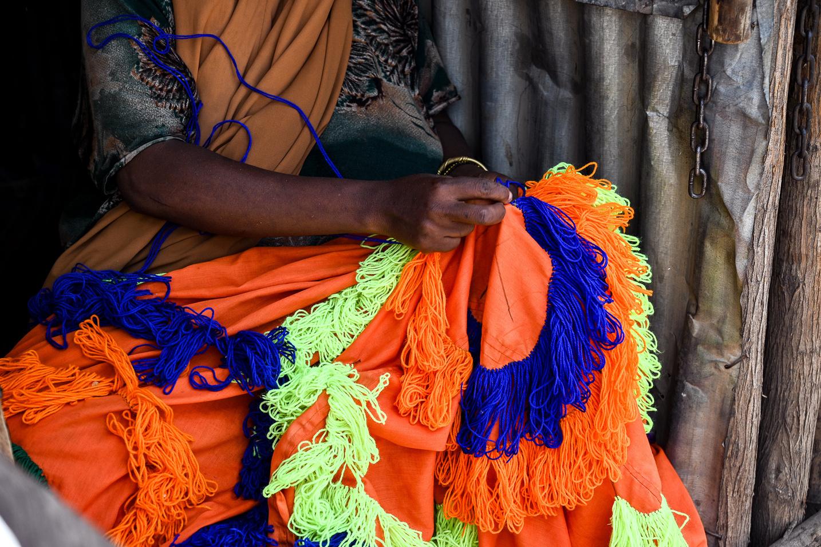



Pillars
Global Refugee Research
Programme
Global Migration Governance and Advocacy Programme
Community Engagement
Notes:
Global Refugee Research Programme
GRD will undertake research projects to inform our programming which includes both primary and secondary research
GRD will endeavor in qualitative, quantitative or mixed research methods where appropriate
GRD will work alongside key stakeholders to inform our projects such as individuals with lived experience of forced displacement, policy or law makers, government officials, I/NGO representatives, and related.
“Nothing about us, without us”
Global migration governance and advocacy programme
Through our research, we will identify/highlight gaps and challenges in migration governance measures such as policies, laws or frameworks, and provide recommendations
GRD will partner with local organizations which advocate for policy reform for displaced populations to strengthen national and international migration governance measures
We are focused on understanding the gaps that exist between the Global Compact for Refugees its corresponding/implementation instrument - the Comprehensive Refugee Response Framework - and doing research to provide recommendations
Currently, 8 African countries which have agreed to implement aspects of the CRRF - self-reliance is a huge part of it
Global Refugee Community Engagement Programme
GRD will create and lead capacity sharing activities with Refugee-led Organizations which relate to policy & advocacy. This can include strategic planning, program management, public speaking, assisting with governance structures and institutional policies, and related
Beneficiaries will be regarded as equal stakeholders throughout the duration of any project cycle - design, implementation, monitoring & evaluation.

Slide 5
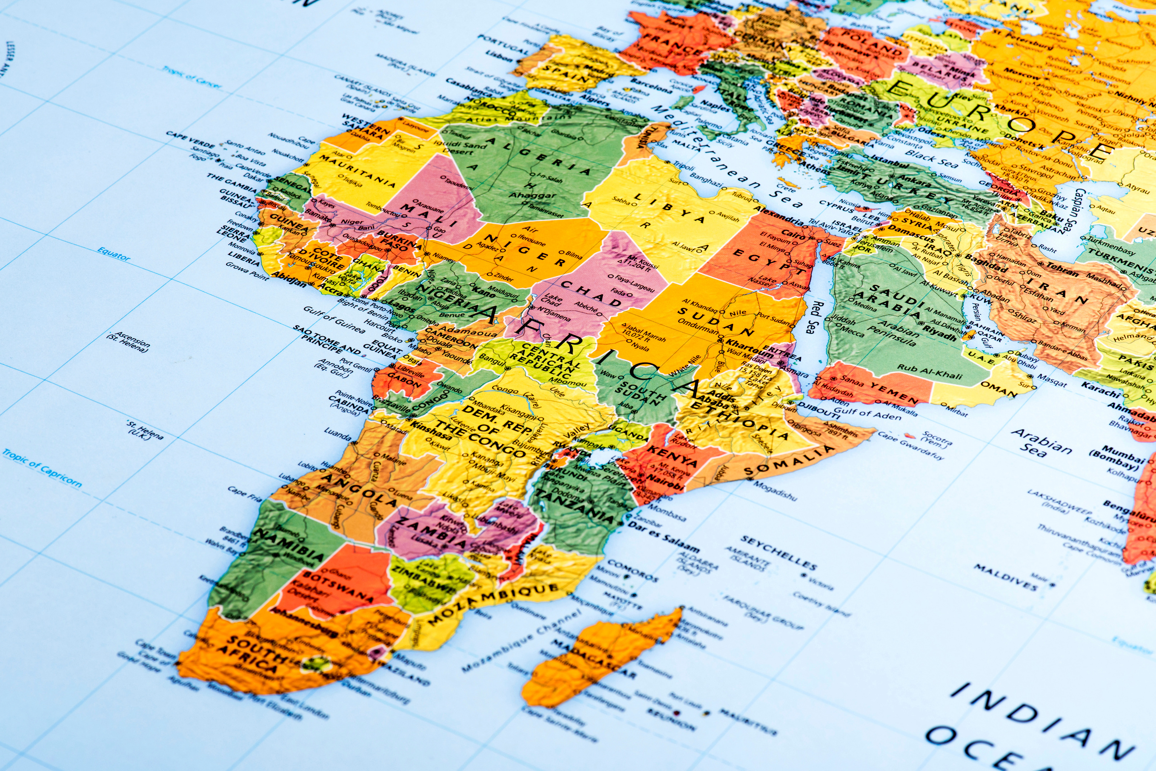
Summary
  This project seeks to explore one reported barrier to socio-economic inclusion and self-reliance - acquiring documentation at Kakuma Refugee Camp, Kenya
  Intends to bridge the gap between access to justice and legal identity and socio-economic inclusion
  Research will focus on the process of acquiring different documents in the camp, challenges involved, documentation-related rights, and the socio-economic implication of possessing or lacking certain refugee documents in the camp.
  Economic inclusion empowers refugees by enabling them to access labour markets, finance, inter alia, and to meet their needs sustainably, avoid aid dependency of negative coping mechanisms, and contributes to their host economies

Slide 6





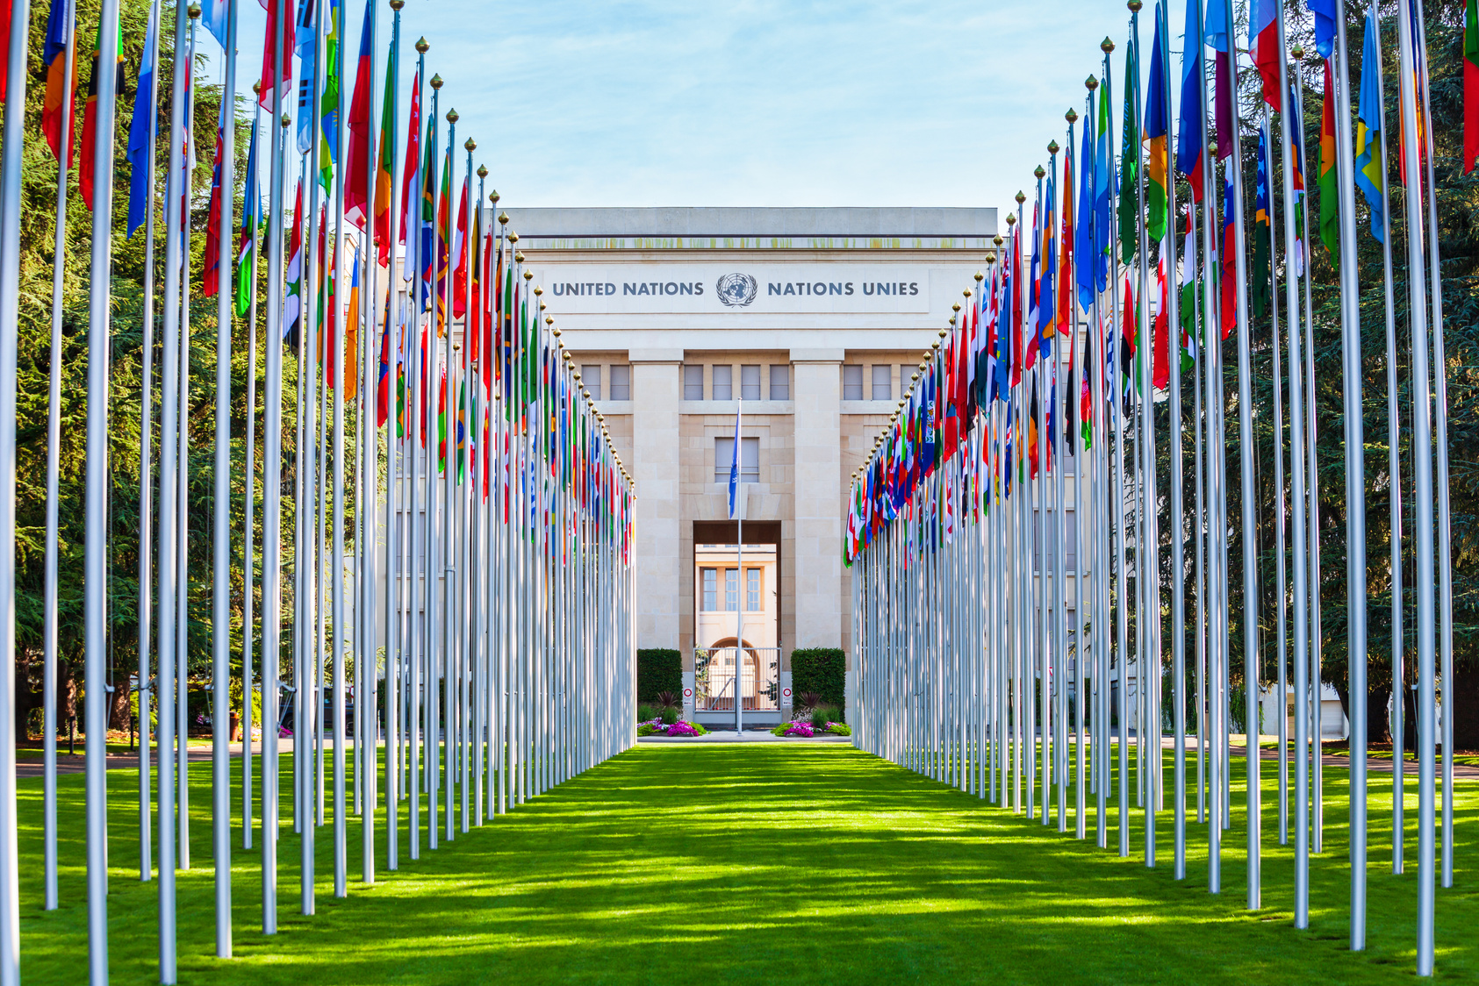
Goals & Objectives
The desired outcome of GRD’s actions shall be to:
To identify the official pathways to accessing documents as a function of four factors: the type of documentation, the agency providing the documentation, the evolution of the RSD process, and the personal histories and contexts of refugees in Kakuma
01
To determine awareness of these pathways among refugee residents in Kakuma
02
To document strategies and pathways refugee residents of Kakuma take to access necessary documentation as a function of these same four factors
03
04
To identify the kinds of barriers faced by refugees in these different circumstances; and to describe the consequences of delays and denials on refugees’ socioeconomic integration and general well-being

Slide 7





Approach
Research focuses on self-reliance through strengthening migration governance frameworks
  Steps:
    Secondary data; Literature review & analysis
    Primary data; mixed methods
  Primary data; mixed methods
    GRD will collect data with Key Information Interview and surveys built in Kobo Collect
    Sample size: 384 individuals, 64 surveys, 15-day period, 288 hours
    Exported to SPSS and chi square

Slide 8


Theme
What are the most pressing challenges with registration and documentation for refugees in Kakuma?
Challenges to Obtain ID
Types of registration have their own unique challenges. We are considering:
  Registration of new arrivals for asylum seekers
    Movement pass and asylum seeker case transfer
  Access to healthcare services
    Giving birth at accredited healthcare centre or hospital
      Birth certificate application
  Education
    Harmonized system for refugees to access government & private sector scholarships
  Employment
    Class M Work Permit
    Business licenses
  National Transport and Safety Authority (NTSA)
    Accessing Transport Integrated Management System (TIMS account)
    Access to ownership rights (moveable property like vehicle or motorbike)
  Kenya Revenue Authority (KRA) Pin
    Bank account registration
    Access to credits
    Conventional Travel Document

Slide 9
Theme
What are the most pressing challenges with registration and documentation for refugees in Kakuma?
Challenges within systems
Unsynchronized systems:
Systems are segmented and do not communicate cross-sectorally
Issues with System Digitization:
  Transition from manual to digital, bio data collection & renewal
  Previous refugee ID had 6 numbers, now has 8
Government priorities do not always align
  varied priorities between national and county

Slide 10
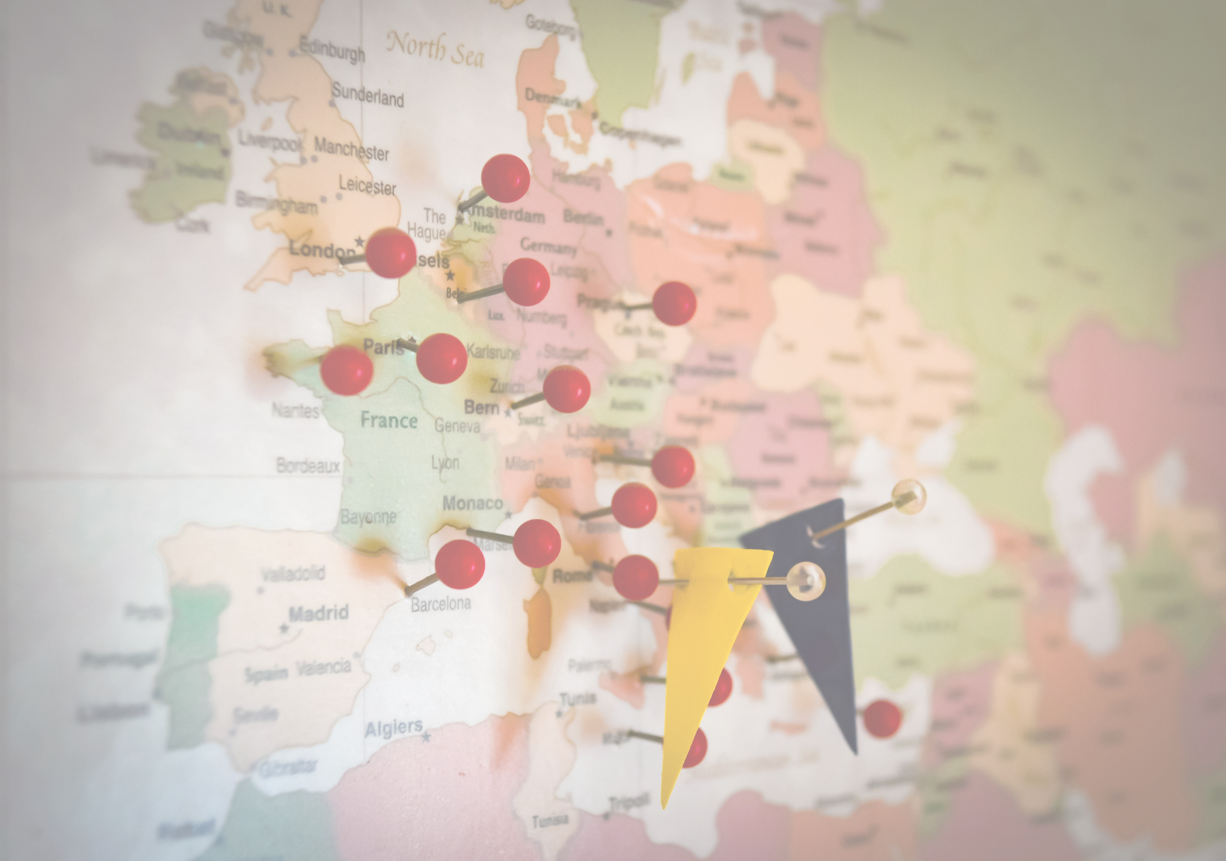
Observations - Challenges with ID & Documentation
  Increase transparency - provide more information & clarity around registration process, wait times, status of application among others
  Lift restrictions or resume registration for asylum seekers in Nairobi
  Expand registration services to other counties with larger populations of asylum seekers to reduce travel expenses
  Ease restrictions on transfer of cases from Kakuma to Nairobi for those people (with special cases) who were given movement passes and registered as Kakuma asylum-seekers but never moved there
  Universal/unified tool to collect data to be used and referenced by all relevant actors in this space

Slide 11

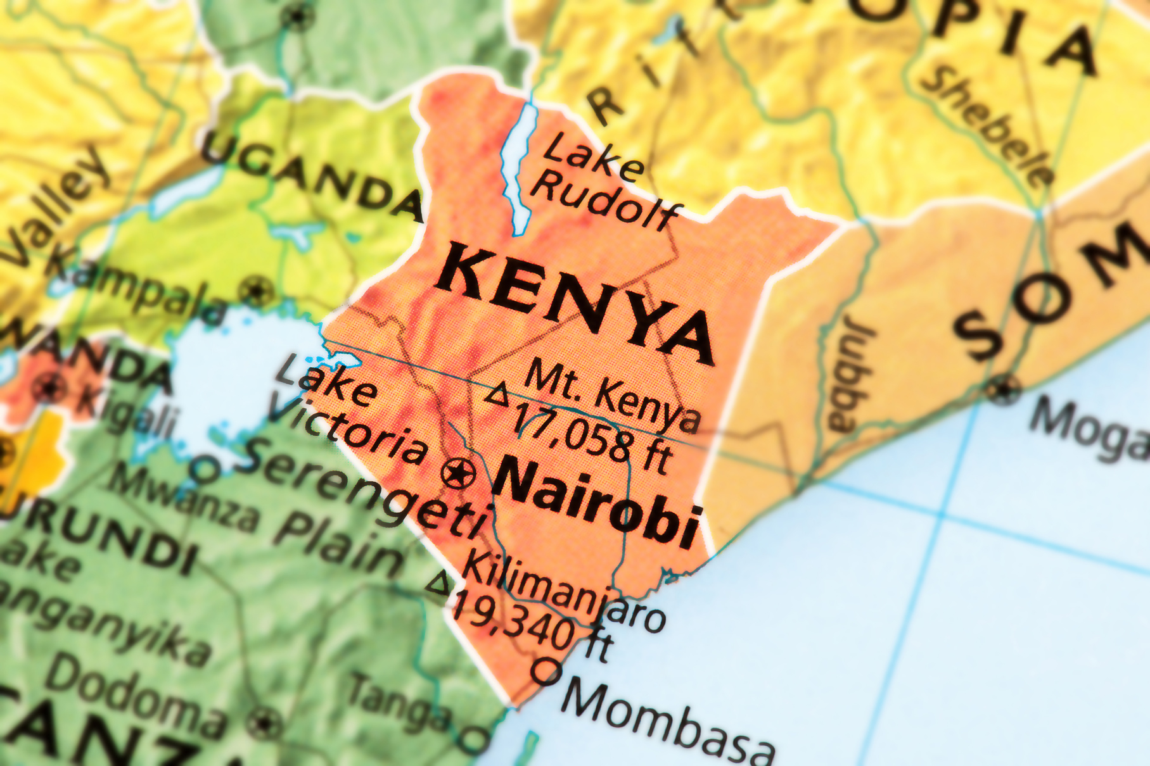
How do these challenges operate as barriers to positive socio-economic outcomes?
01
Employment
  Citizenship & Immigration Act require those seeking employment apply for Class M
  Many barriers for refugees - employers must justify why not Kenyans, arduous process and documentation requirements (7), difficulty in accessing application platform, long wait times, inaccess to feedback on application, low success rates, short validity period (2 years)
  Contrast to business license application - seemingly more efficient and higher success rate

Slide 12
How do these challenges operate as barriers to positive socio-economic outcomes?
02
Employment
  Citizenship & Immigration Act require those seeking employment apply for Class M
  Many barriers for refugees - employers must justify why not Kenyans, arduous process and documentation requirements (7), difficulty in accessing application platform, long wait times, inaccess to feedback on application, low success rates, short validity period (2 years)

Slide 13
How do these challenges operate as barriers to positive socio-economic outcomes?
02
Education
  Review school admission and national examination
  Challenges to register for the Kenya Certificate of Primary Examination and the Kenya Certificate of Secondary Examination
    Cannot be accessed without proof of registration/manifest letter
  High drop out rates as it relates to access to ID & Documentation
  Acknowledgement of language barriers such as Kenya National Examination Council qualifying test

Slide 14
How do these challenges operate as barriers to positive socio-economic outcomes?
03
Durable Solutions
Without ID & Documentation, refugees cannot gain benefits associated with integrative measures
Socio-economic independence
  Cannot access basic financial services - KRA pin, bank accounts, M-Pesa, business registration & licensing, etc
  Seek employment but are taken advantage of, oftentimes work in informal sector
Sel-reliance
  Refugees need access to services and integrative measures which will be a collective effort of all relevant stakeholders to reduce aid dependency, reduce generational protraction, and enable sustained success

Slide 15
Observations - Socioeconomic Inclusion
  Ease restrictions on obtaining ID & Documentation
  Remove Class M permit and enable people to use their ID as recognized by the government, thereby there is also no need to expand expiry date
  Create an enabling environment for refugees to overcome or allow for integration
  Ensure all policies, laws and frameworks which adhere to refugee integration outline streamlined process to obtain id & documentation
  Ensure all policies, laws and frameworks which adhere to refugee integration are unanimous in their vernacular to ensure universality and uptake
  Academic certificate equivalence, education integration and pursuance of further studies
  Power of CTD for entrepreneurial endeavors & fill labour shortages

Slide 16





How can the current migration governance measures in Kenya strengthen the ability for displaced persons to gain access to ID& Documentation?
Migration Governance: The combined frameworks of legal norms, laws and regulations, policies and traditions as well as organizational structures (subnational, national, regional, international) and the relevant processes that shape and regulate states’ approaches with regard to migration in all its forms, addressing rights and responsibilities and promoting international cooperation.
KISEDP
The New Refugees Act 2021
  Migration plays a critical role in economic growth & development - regulate safe and orderly migration, promotes working aged persons to fill labour market shortages and old-age dependency ratios of host countries
  Without Migration Governance, or ways to integrate FDP, human trafficking, arbitrary arrests & detention, refoulement, amongst others
GISEDP
SHIRIKA Plan

Slide 17
How can the current migration governance measures in Kenya strengthen the ability for displaced persons to gain access to ID& Documentation?
The New Refugees Act 2021: This new law provides the basis for socio-economic inclusion of refugees. The Refugees Act No. 10 of 2021 provides a robust legal framework for refugee protection and solutions, emphasizing the Government's commitment to refugee welfare and finding lasting solutions
KISEDP
The New Refugees Act 2021
  This will enable access to services ssuch as · banking services; access to capital through bank loans; access to M-Pesa services like Till number, Paybill number, Pochi la Biashara, as well as loans services like Fuliza, and Till number business loans; access to work permit; access to CTD; and lastly rights to ownership of business or properties (ability of buying and register a property on their name).
GISEDP
SHIRIKA Plan

Slide 18
How can the current migration governance measures in Kenya strengthen the ability for displaced persons to gain access to ID& Documentation?
KISEDP + GISEDP: These development plans intend to turn Kakuma refugee camp into a permanent settlement, which can now be recognized as Kalobeyei. the GISEDP intends to do the same in Garissa county for Dadaab refugee camp. These development plans alongside the Support for Host Communities and Refugee Empowerment (SHARE) are part of the SHIRIKA plan’s implementation plan.
KISEDP
The New Refugees Act 2021
GISEDP
SHIRIKA Plan

Slide 19
How can the current migration governance measures in Kenya strengthen the ability for displaced persons to gain access to ID& Documentation?
SHIRIKA Plan: The SHIRIKA Plan is the Government of Kenya's pioneering innovative approach for the Refugee management in Kenya and is aimed at transforming the refugee camps into integrated settlements supporting the socioeconomic inclusion of refugees and hosting communities in Garissa, Turkana, and urban areas. It builds upon the existing achievements to promote sustainable inclusion and has instituted milestones to achieve its goals. The Shirika plan includes six (6) envisioned key components.
  Does not mention facilitated pathways towards refugee ID & Documentation in any of its 6 pillars
KISEDP
The New Refugees Act 2021
GISEDP
SHIRIKA Plan

Slide 20
Observations - Migration Governance
  All migration governance measures should outline universal standard to obtain ID & Documentation and all processes involved to mitigate confusion and ensure efficiency/transparency
  SHIRIKA Plan should further explicate ID & Documentation process in its first two components: Systems-building and enabling policy frameworks; Integrated services
  For refugees to attain socio-economic inclusion, their ID needs to be recognized by the authorities at all levels, as well as in the private sector. This means the IDs should be recognized at national, county, and local levels
  Create/enable avenue for naturalization process to reduce generational protraction

Slide 21

Justification
  Research on registration and documentation for refugees in Kenya will allow us to demonstrate difficulties in obtaining vital documents to participate and propsper in Kenya society
  Challenges include: backlog, unsynchronized systems, inconsistencies and delays, lack of clear information, administrative issues prevent individuals from socio-economic integration
  Outlining these challenges will deepen the practical knowledge and provide evidence-based research to inform future advocacy efforts & recommendations to strengthen migration governance in Kenya
  Socio-economic integration enables decreased aid dependency, reduce resource pressure, prevent generational cycle of born displacement

Slide 22


Evaluation
GRD has adapted GAC’s RBM methodologies and tools as “managing for results” approach for its development programmes or projects
Theory of Change
  Theory of Change
    Description and illustration of how and why a desired change is expected to happen
  Logic Model
    Outlines the logical flow between outputs and expected results
  Performance Measurement Framework
    Framework which summarizes RBM monitoring & strategy
  Key Performance Indicators
    Keep track of interest at the organizational level
Logic Model
Performance Measurement Framework
Key Performance Indicators

Slide 23



Ethics
  Those with lived experience of forced displacement will be included throughout all aspects of the project cycle: Planning, implementation, knowledge dissemination
  We will only interview individuals who can provide genuine, voluntary and informed consent.
  We will uphold the tenet “Do no Harm” and prioritize the dignity, safety and well-being of participants, partners, research assistants, interpreters and researchers
  In applying research we will uphold the principles of Autonomy, Equity, Diversity, Competence, Partnership
We will uphold, apply and adapt the key ethical principles of voluntary, informed consent; confidentiality and privacy; and “do no harm” to the specific contexts of forced migration. We also commit to work towards ensuring that our research improves people’s situations whenever possible. We acknowledge that the heightened risks that forced migration poses to both participants and researchers (as well as people who identify as both) requires proactive, thoughtful engagement and continuous critical reflection.
‘Nothing about us, without us’

Slide 24



Knowledge Dissemination
Report
Conferences
Social Media
  Publish Report on Our Findings
  Share with Partners
  1-page flyers for refugees on information
  Nairobi
  Kakuma Refugee Camp
  Online Panel
Infographics, summaries, videos discussing findings of our project

Slide 25
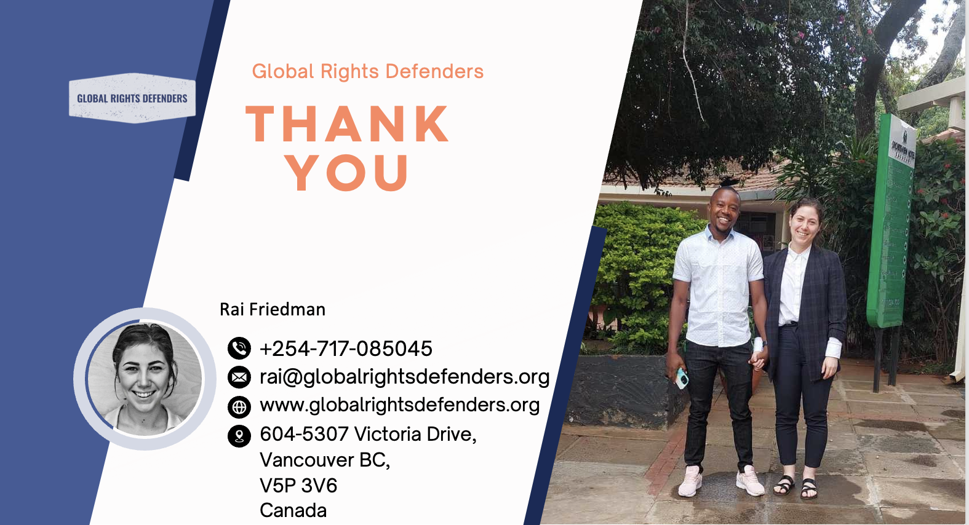
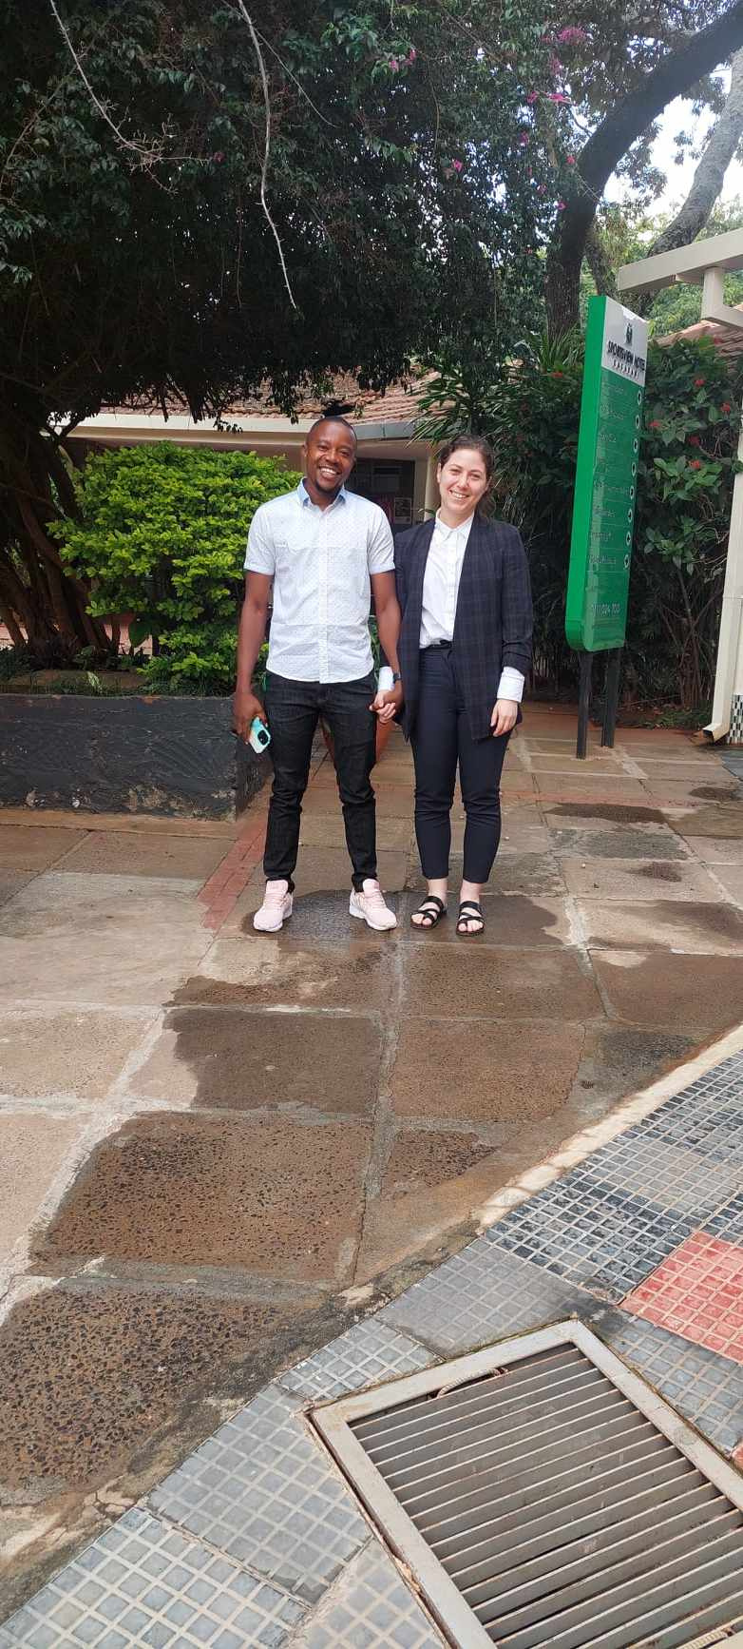
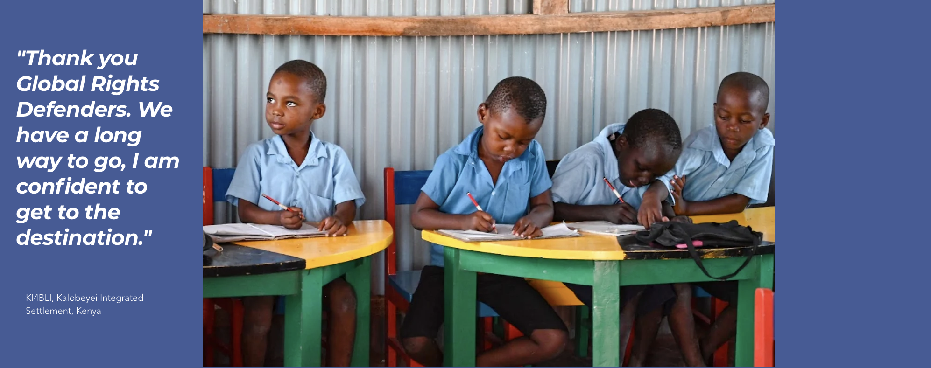
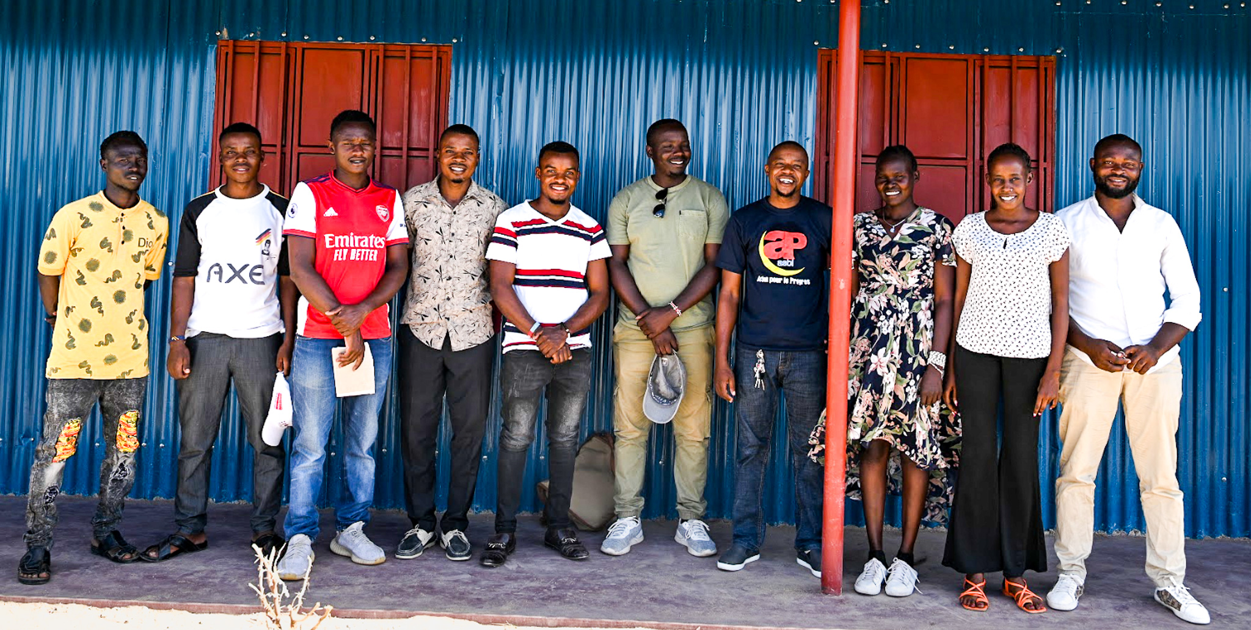
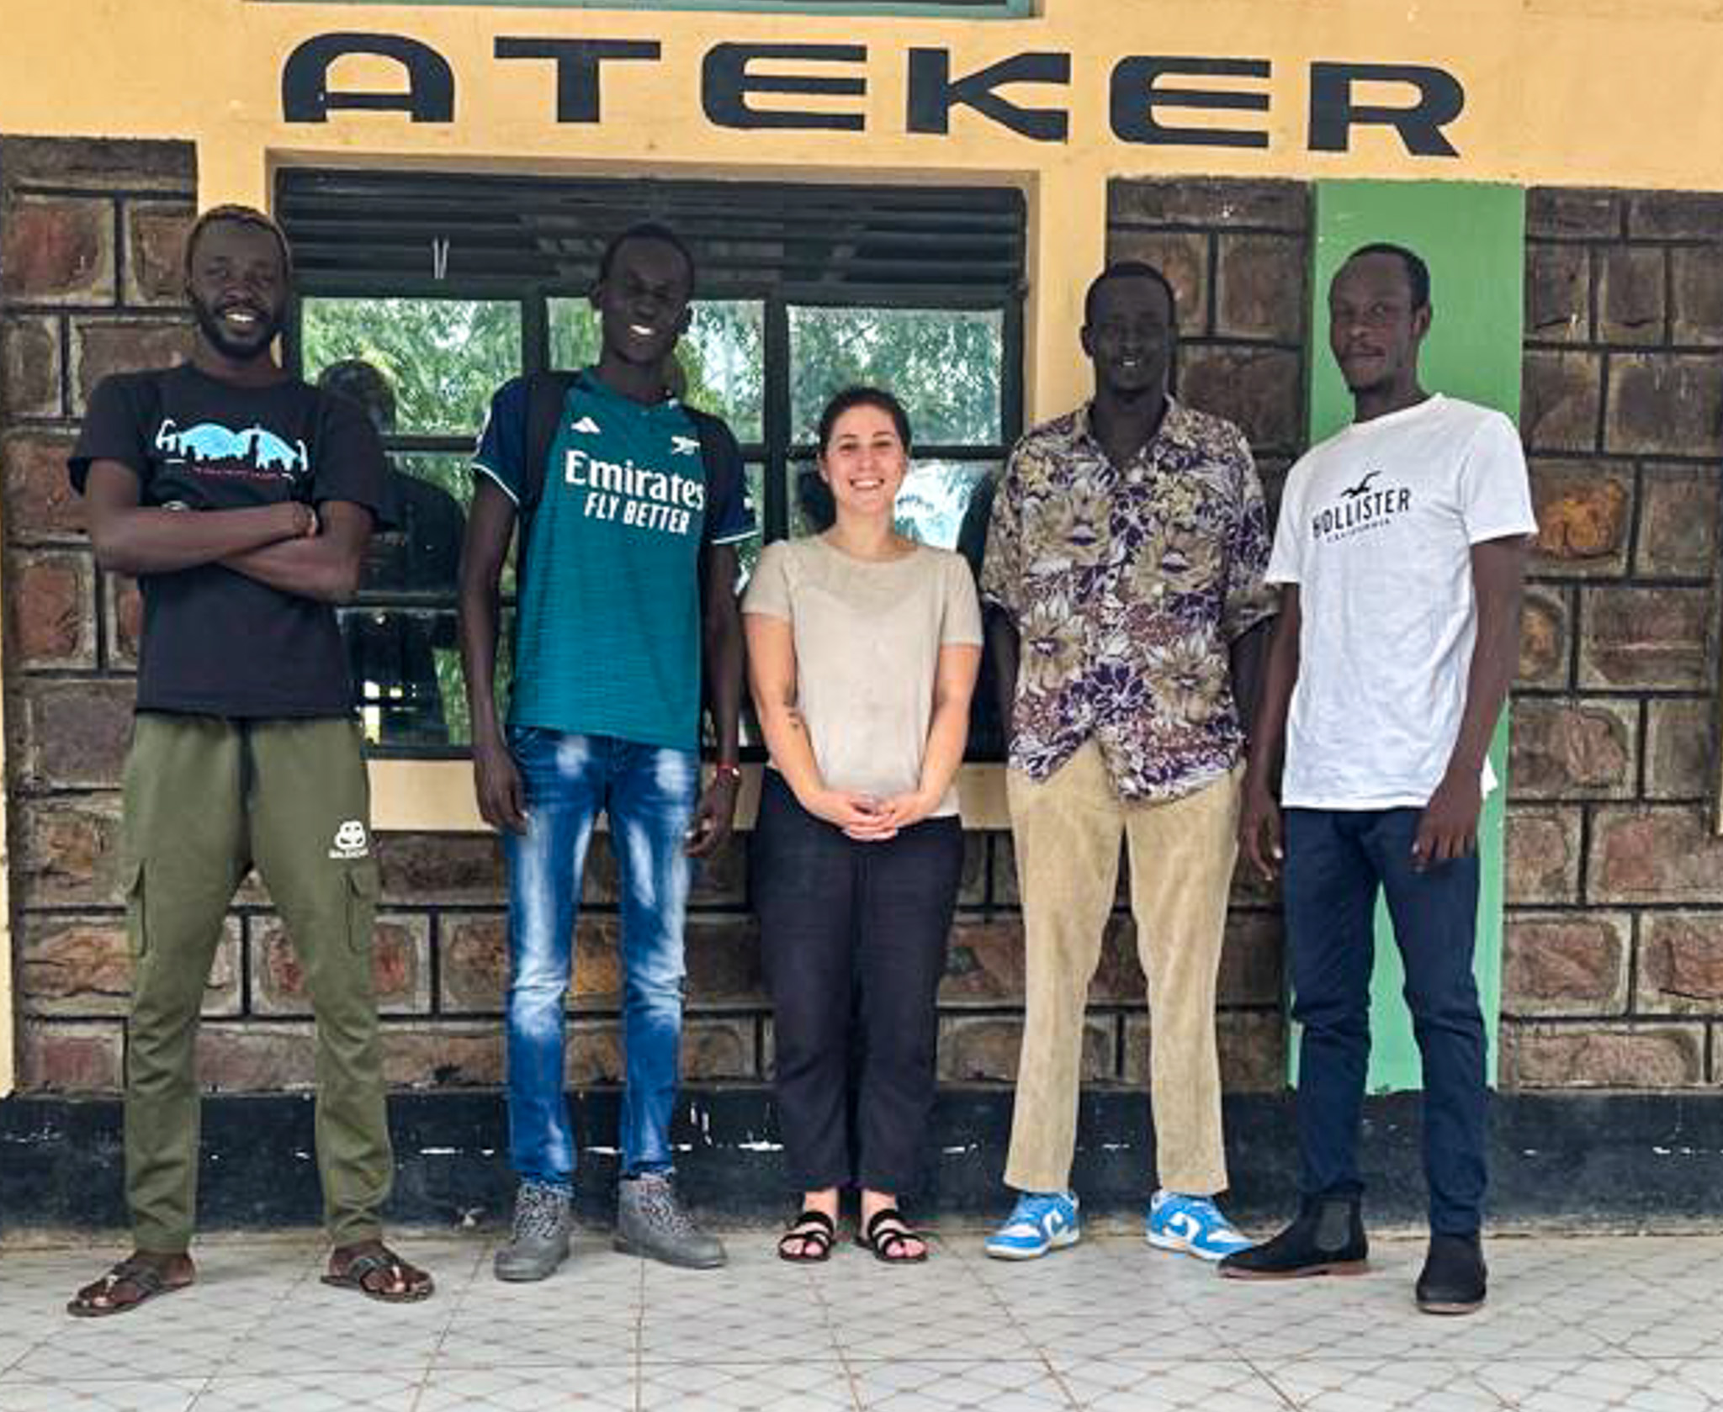
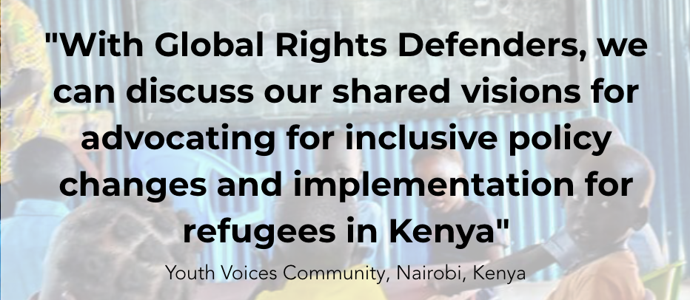
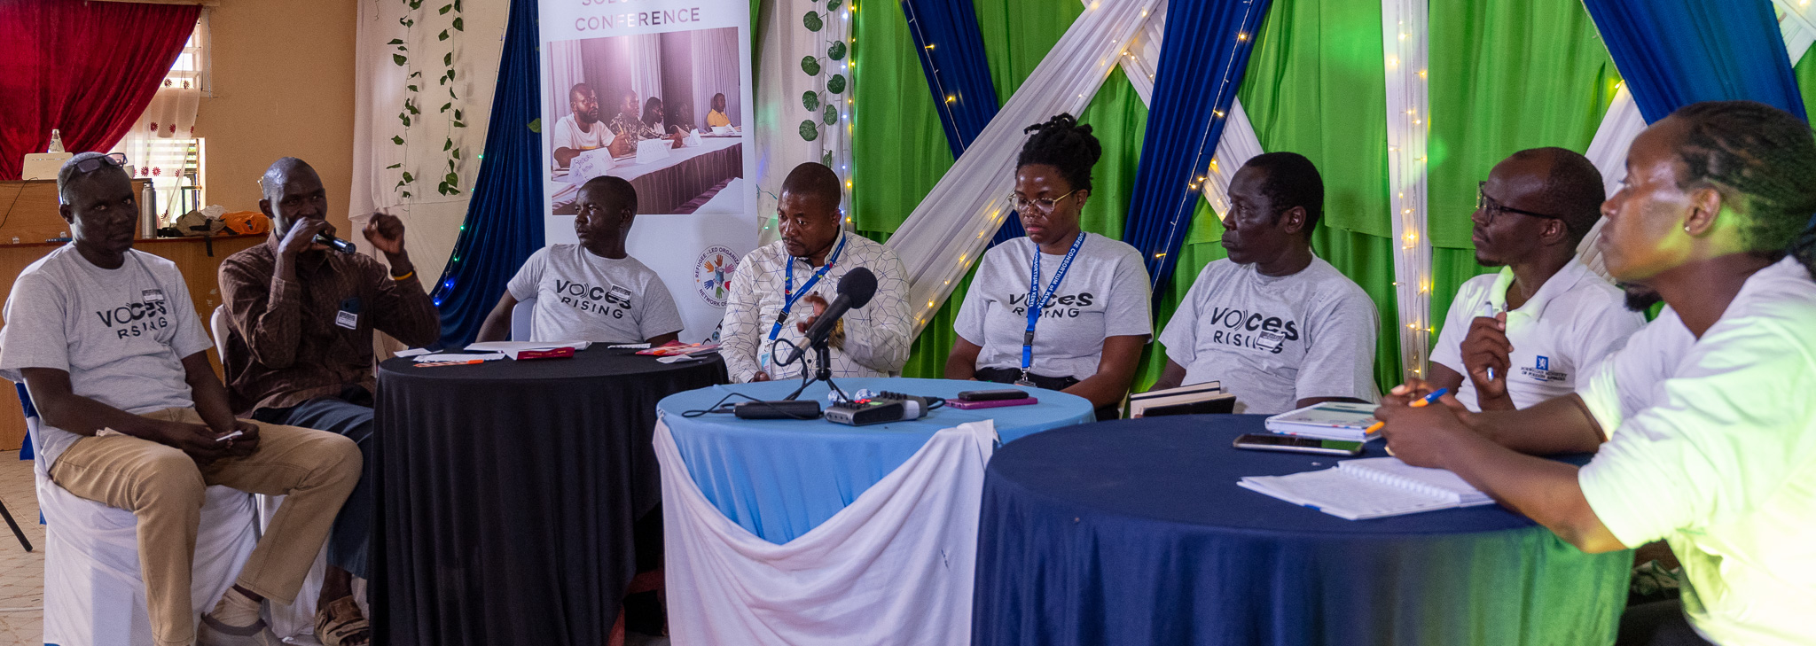





Global Rights Defenders
THANK YOU
Rai Friedman
+254-717-085045
rai@globalrightsdefenders.org
www.globalrightsdefenders.org
604-5307 Victoria Drive, Vancouver BC,
V5P 3V6
Canada
Notes:
Leadership
So why do I bring all of this up?
To be a leader in our space it is imperative to realize that global refugee regime which has existed for 70+ years does not meet the current needs
Being a leader in today’s field is realizing how important it is to find durable solutions to the global refugee crisis
By being experts in migration governance, and prioritizing self-reliance, GRD is being part of the new wave of humanitarianism where we include people with lived experience of forced displacement throughout the entirety of our project cycles
Self-reliance is an important key since it reduces an individuals aid-dependency, builds their capacities, promotes economic growth for host communities and host countries,
New wave of humanitarianism
“Nothing about us, without us
Understanding gaps and challenges in integration policies will help inform future policies and protect and promote the rights of displaced persons
Self-reliance will be a critical component to durable solutions to the refugee crisis
We use our platform to amplify the voices of the stories untold or unheard

