Slide 1




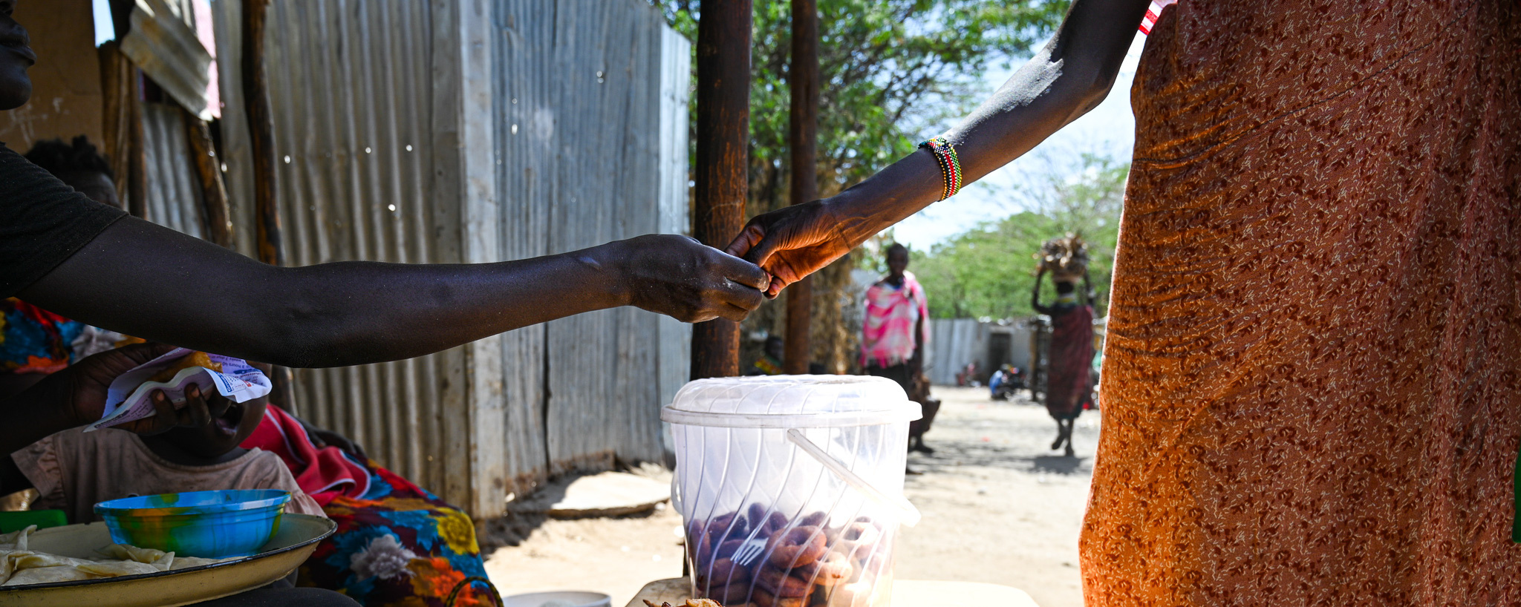




THE IMPORTANCE OF LOCALISATION
Presentation by Rai Friedman
24 May 2025
www.globalrightsdefenders.org

Slide 2

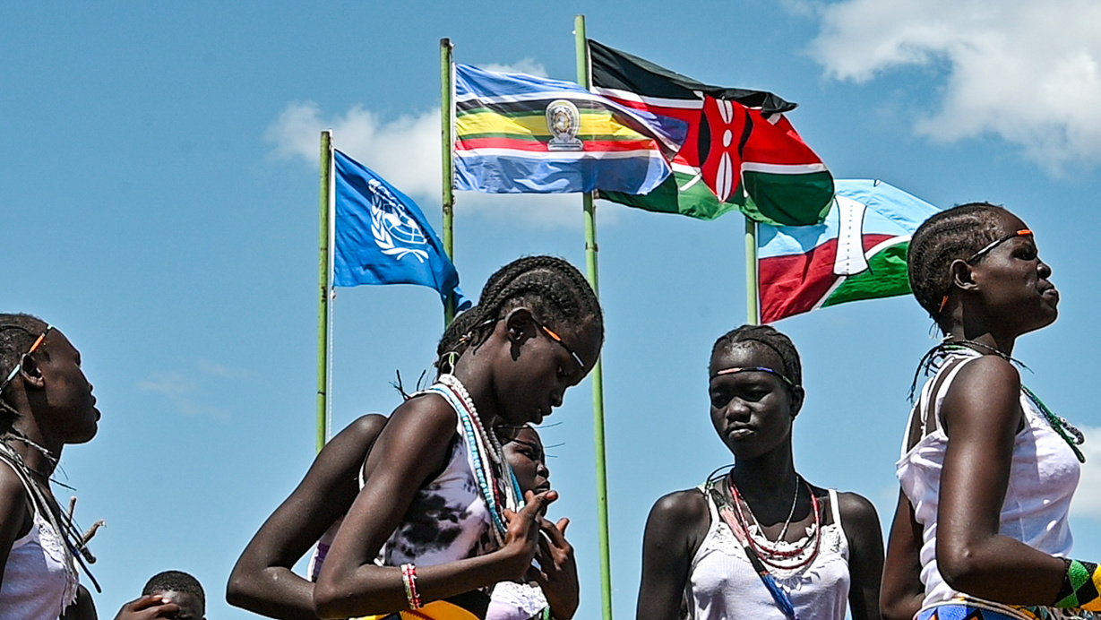


Introduction
Local actors are often the most effective to respond to humanitarian disasters due to their proximity, position within their community and understanding of local contexts.

Slide 3
Localising Humanitarian Action
Humanitarian Action
Localisation
Refugee-led Organisation
  Service-delivery in emergency situations to save lives and alleviate suffering (barnett and Weiss 2011)
  Buzzword in humanitarian sector: acknowledges central role of local actors in all phases of humanitarian response
  An organization or group in which persons with direct lived experience of forced displacement play a primary leadership role and whose stated objectives and activities are focused on responding to the needs of refugees and/or related communities. (UNHCR)
  Strengthening local actors believed to address shortcomings of current system, increasing aid effectiveness and power imbalances
  Local actors are local non-profits, faith-based organisations and Refugees

Slide 4

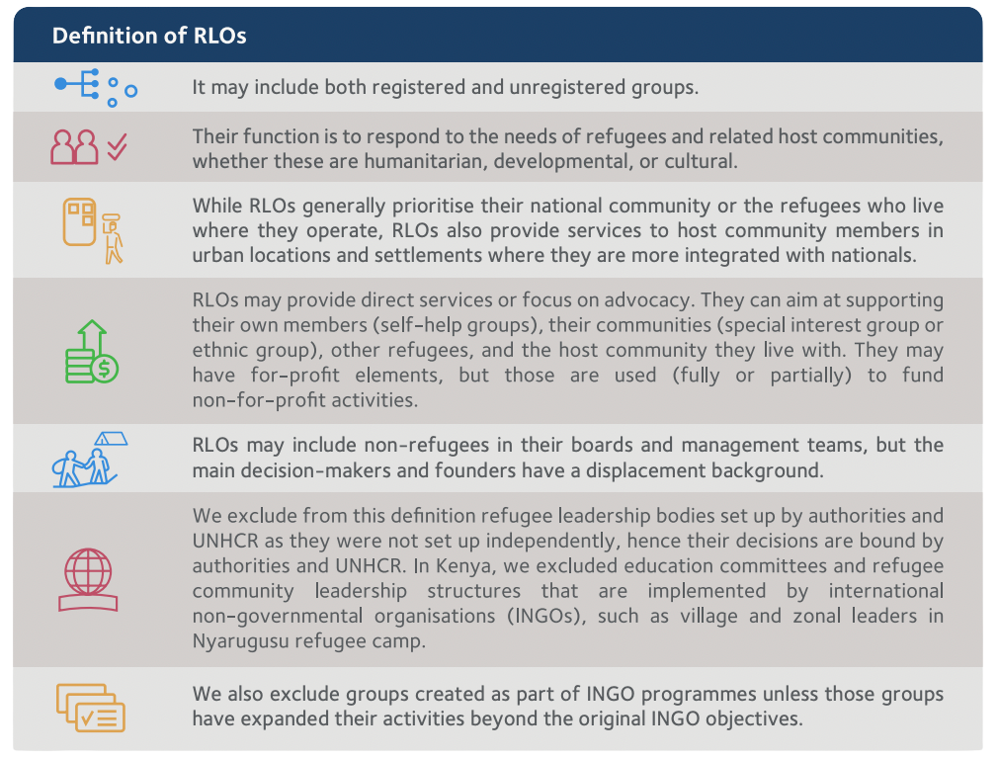
Refugee-led Organisation (RLO)
  Source: Yousif Kara, A. (2022). ‘Refugee-Led Organisations in East Africa: Community Perceptions in Kenya.’ Refugee-Led Research Series, Research Report (3), November 2022.

Slide 5

How the Humanitarian System Operates
Humanitarian organizations operate by providing life-saving assistance and protection to people affected by crises such as armed conflict, natural disasters, forced displacement, and public health emergencies. Their operations are guided by core humanitarian principles—humanity, neutrality, impartiality, and independence—and typically involve complex logistics, partnerships, and coordination mechanisms.
Overview of Operations:
  Needs Assessment
    Identify urgent needs and conduct foreground analysis to develop project
  Program Design & Planning
    Designed based off assessment finding & community input
  Funding and Resource Mobilization
    Gov donors, UN agencies, private foundations,individual donors
  Field Operations & Implementation
  Monitoring, Evaluation & Reporting
  Partnerships & Localization
  Advocacy & Protection
  Etc

Slide 6
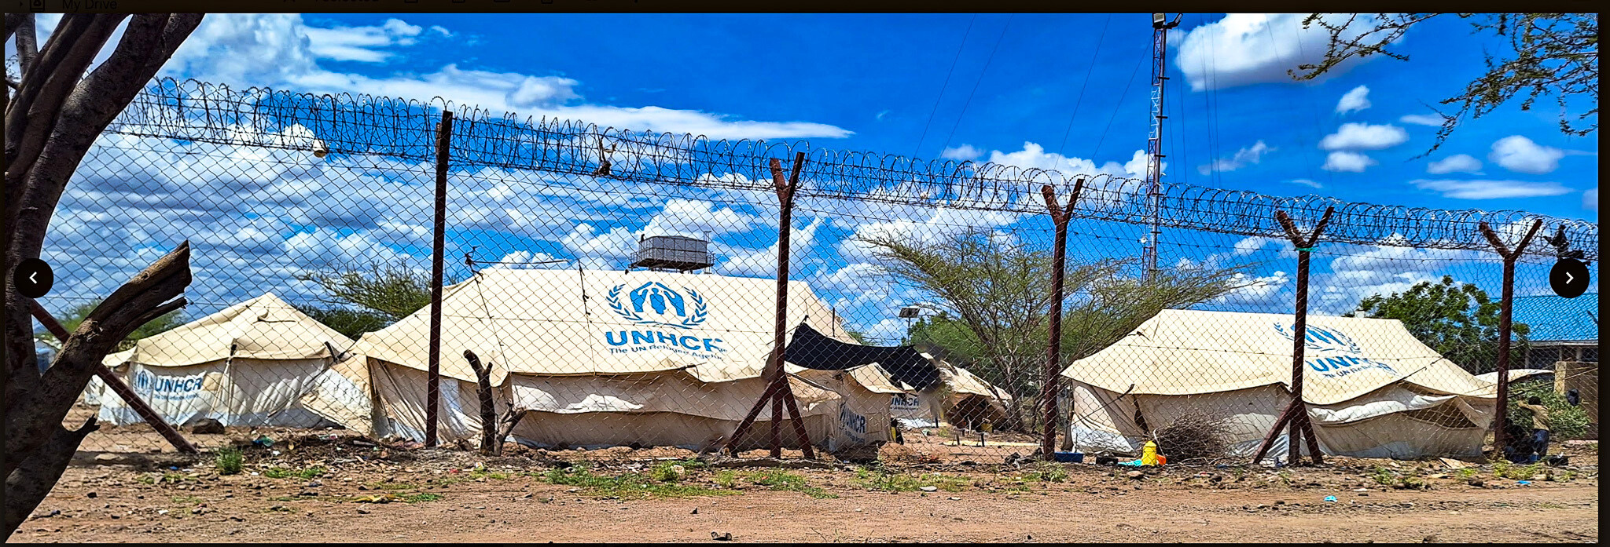
Criticisms of the Humanitarian System
  Top-Down Donor Driven Approach
    Lack of local ownership; impose own solutions without understanding local contexts
  Neo-Colonial and Power Imbalances
  Lack of Sustainability
    Short-term focus - short funding cycles; Creates need for aid-dependency
  Inefficiency and Waste
    High admin costs; duplication of efforts
  Failure to Address Root Causes
  Insufficient Community Involvement
  Unintended Negative Consequences
    Environmental harm, cultural erosion
  Issues with Accountability and Transparency
    Misappropriation of funds, real impact difficult to measure
  Aid & Donor Fatigue
  Etc

Slide 7
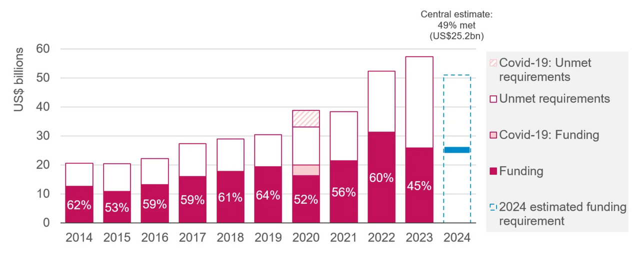

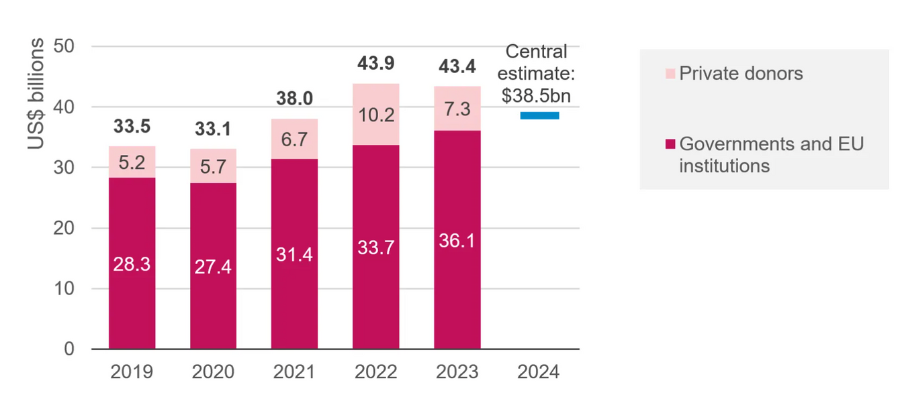


FUNDING GAP/EFFECTIVENESS PRE - 2025 BUDGET CUTS
FUNDING GAP AND SHORTFALL
$32 B
2023 - Int’l Humanitarian Assistance remained high (USD 43 B), interagency apeals faced USD 32 B funding gap
  Largest on record - lowest since 2019
  Millions did not receive support
  Tightly earmarked donor funds for specific projects
BUDGET CUTS
Key donors and organizations are making budget cuts across the sector
  decrease in development initiatives
  Source: Development Initiatives based on UN OCHA FTS, data extracted 19 July 2024 – 2024
DONOR FATIGUE
  Pressure on foreign aid budgets, changes in funding policy, over-reliance on single sources of funding, the increasing numbers of NGOs competing for funds for similar projects and overexposure on a particular issue
  Ran out of compassion for prolonged refugee situations
CRISES ARE LONGER + COMPLEX
Prolonged conflict/instability, encampment policies, ineffective durable solutions, weak integration policies, uneven responsibility sharing
  Source: Development Initiatives based on UN OCHA FTS, UNHCR and Syria 3RP financial dashboard data

Slide 8
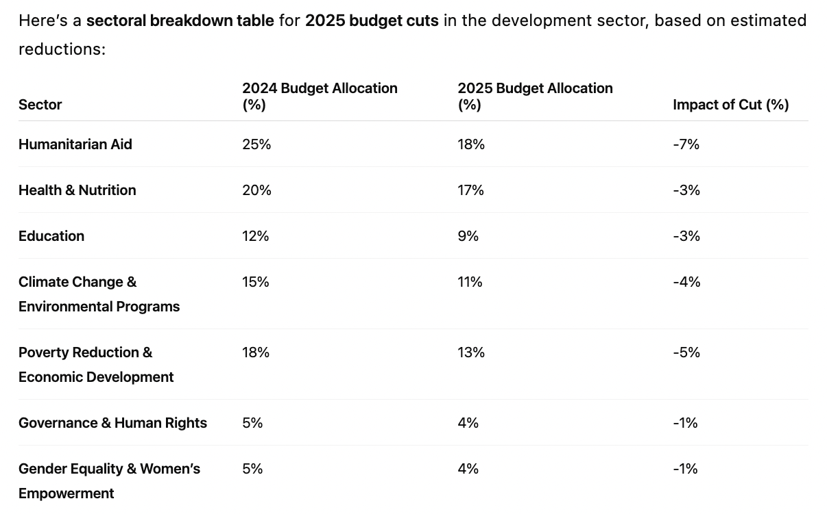
FUNDING GAP/EFFECTIVENESS - 2025 BUDGET CUTS
  Source: Estimates from ChatGPT

Slide 9





2025 SHIFTING GLOBAL NORMS
GLOBAL ECONOMIC DOWNTURN
CUTS TO MULTILATERAL FUNDING
  Donor countries experiencing economic stagnation, inflatoin, recession or uncertainties
  Domestic financial challenges & supplementation of defence spending led to decrease in foreign aid
  Decreased contribution to UN and multilateral organizations
    led to downfall in funding for global dev programs
  US decreasing soft power and democratic values worldwide which affects types of programming
SHIFTING POLITICAL PRIORITIES
  Rise in nationalism & protectionism; US taking “America First” style approach
  Rise in Geopolitical tensions - reallocation of funds to defense & security
IMPACT ON GLOBAL ORGANIZATIONS
  Decreased funding for local actors, RLOs, significant drop in core funding & ability to operate
DONOR FATIGUE
CONSEQUEQUENCES FOR GLOBAL DEVELOPMENT
  Pressure on foreign aid budgets, changes in funding policy, over-reliance on single sources of funding, the increasing numbers of NGOs competing for funds for similar projects and overexposure on a particular issue
  Ran out of compassion for prolonged refugee situations
  Choosing to spend on emergency situations - climate, pandemic, etc
  Set back in Sustainable Development Goals (SDG)
  Set back in research and ability to provide data/statistics/advocacy
    loss of expertise
    retrenchment of human rights
  Decreased economic opportunity worldwide
  Increased risk of precarious health
  etc

Slide 10

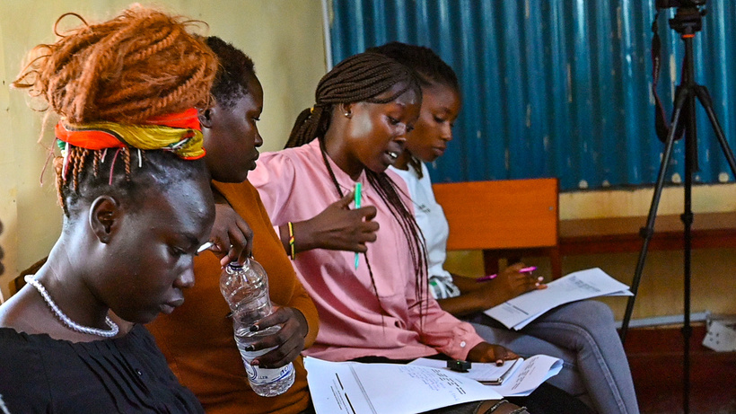

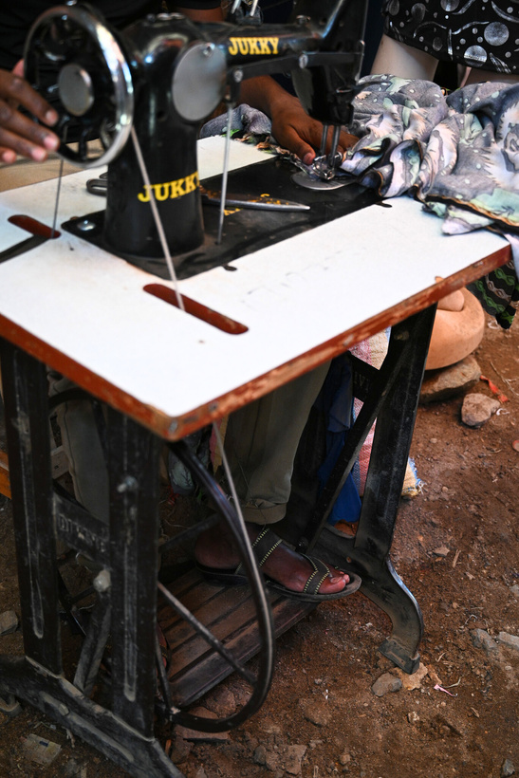
Advantages of Local Actors
Local Actors such as Refugee-led Organisations (RLO) should be funded over large international organizations since it can lead to more effective, equitable and sustainable development and humanitarian outcomes for the following key reasons:
Local Knowledge and Contextual Understanding
Trust & Access to Communities They Serve
Cost-Effectiveness & Faster Response Time

Slide 11
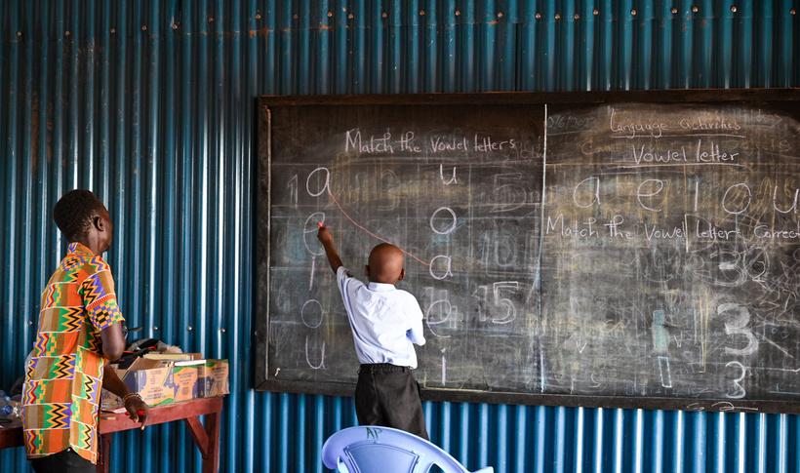
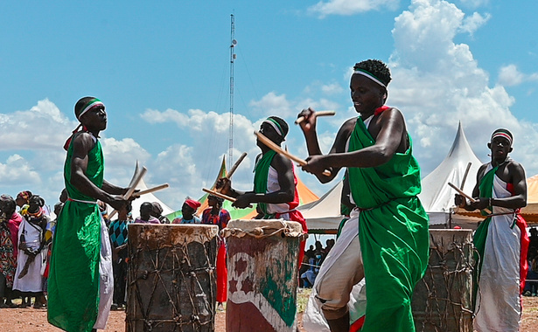
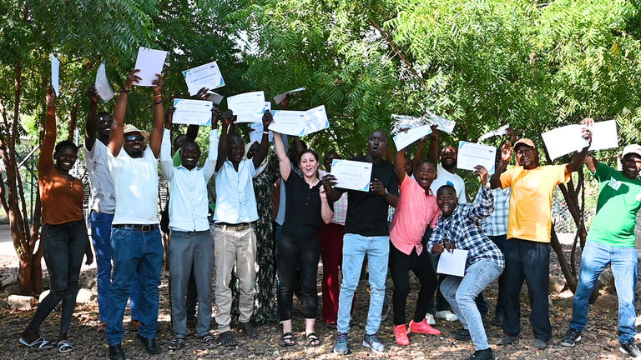
Advantages of Local Actors
Capacity-Building and Sustainability
Accountability & Equity
Aligns with Global Commitments

Slide 12
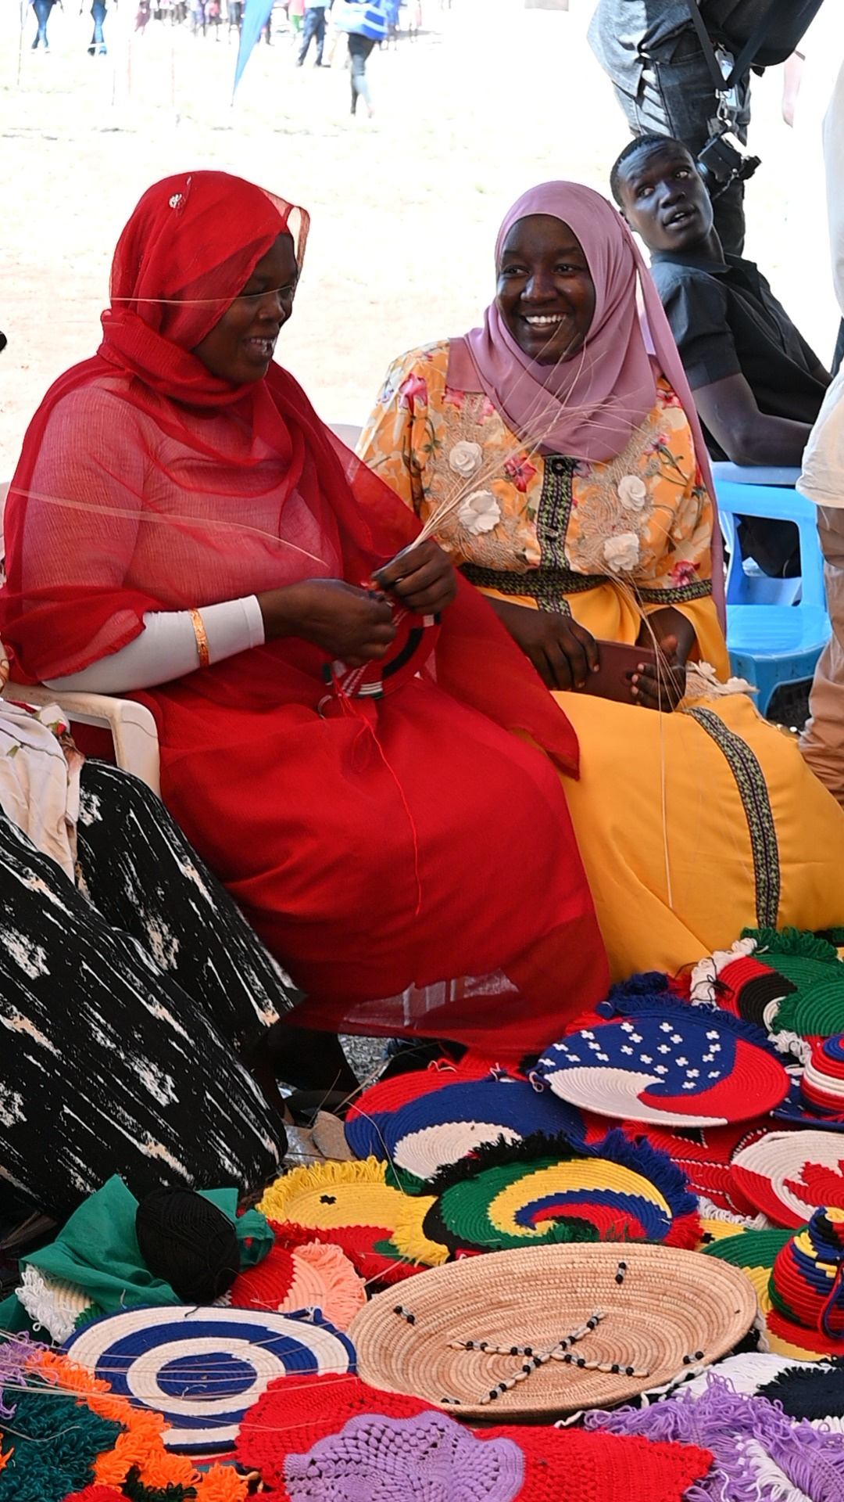



Call for Reform: Support Refugee-led Organisations (RLO)
Flexible Funding
Direct, multi-year, and core funding devoid of rigid donor requirements
Capacity-building Support
Technical assistance, training, mentorship to enhance skills, abilities and knowledge of RLO staff
Prioritizing local actors rebalances power, by increasing impact, and fostering systems that are more just, effective, and resilient.
Legal Recognition
Legally recognize RLO to enable them to receive grants & other benefits; allow them to operate in host countries
Visibility & Advocacy
Amplify voices & perspectives of RLOs to better serve affected communities; meaningful participation
Parterships with Int’l
Strengthen participation with I/NGO, UN, donors, gov, etc without comprimising autonomy

Slide 13
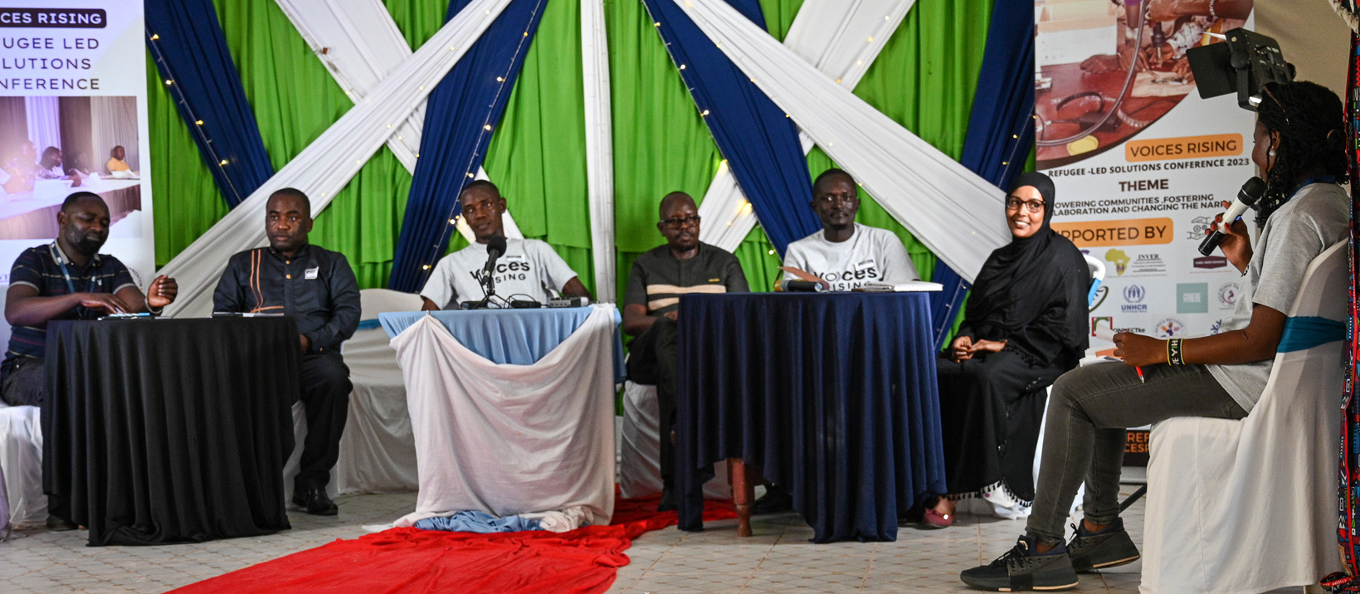




ABOUT
GLOBAL RIGHTS DEFENDERS
Migration
Governance
Self-Reliance
Capacity Sharing
Global Rights Defenders (GRD) is a Canadian non-profit which advocates for refugee and human rights worldwide. We do so through research, policy analysis & advocacy and community engagement.
Our work consists of working with individuals with lived experience of forced displacement, and campaigning for the promotion and protection of displaced persons rights. Our work is guided by international human rights and refugee law, and respect for the dignity of each human being.

Slide 14

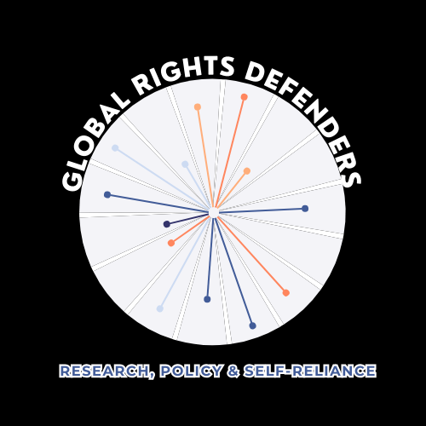

MANDATE
to determine durable solutions to the global refugee crisis through strengthening migration governance measures as established in the Global Compact for Refugees.
to create an inclusive society for all, where displaced populations can be safely protected within host societies and be shielded from discriminatory practices as defined and prohibited in the 1951 Refugee Convention, and its 1967 Protocol
Mission
to empower displaced populations to achieve socio-economic independence and self-reliance, and to build their capacities to ensure that their rights, freedoms and dignities are being upheld and valued.
Vision
Goals

Slide 15

About
  GRD advocates for refugee and human rights through research, policy & advocacy and community engagement
Research
GRD’s key research activities include:
  Primary & secondary research with local partners regarding:
    Socio-economic Integration
    Strengthened Migration Governance (i.e. GCR, CRRF & GCM)
    Localisation of Knowledge
Policy & Advocacy
  Evidence-based research shapes all policy projects & campaigns
  GRD engages with relevant stakeholders including displaced populations, civil society organizations, I/NGOs, government institutions
  GRD partners with relevant actors to engage in meaningful direction
Community Engagement
‘Nothing About Us, Without Us’
  GRD creates & facilitates capacity building activities with displaced populations and host community members
    Focus on institutional capacity building for RLO/CBO + Project Management
  GRD facilitates programs and opportunities to amplify the voices of displaced populations and host community members
  GRD participates and hosts outreach activities such as podcasts, panels, forums, symposiums, town halls, and related - in person and online

Slide 16






GRD PROJECTS
TWO SUBMISSIONS TO THE HUMAN RIGHTS COUNCIL
PUBLIC FORA:
SYMPOSIUM, PANELS, PODCASTS
CAPACITY BUILDING WITH RLO’S + CBO’S
RESEARCH STUDY: UNDERSTANDING SOCIO-ECONOMIC BARRIERS FOR REFUGEES IN KENYA: ID & DOCUMENTATION
RESEARCH STUDY: LESSONS FROM REFUGEE SETTLEMENT DEVELOPMENT PLANS: AN ANALYSIS OF KALOBEYEI, GARISSA AND SHIRIKA
  PROJECT MANAGEMENT
  INSTITUTIONAL CAPACITY
LEGAL & PROTECTIVE MEASURES
RESEARCH STUDY: AN ALTERNATIVE TO REFUGEE DURABLE SOLUTIONS: THE POWER OF THE EAST AFRICA COMMUNITY CITIZENSHIP
STAKEHOLDER & REFUGEE ENGAGEMENT

Slide 17
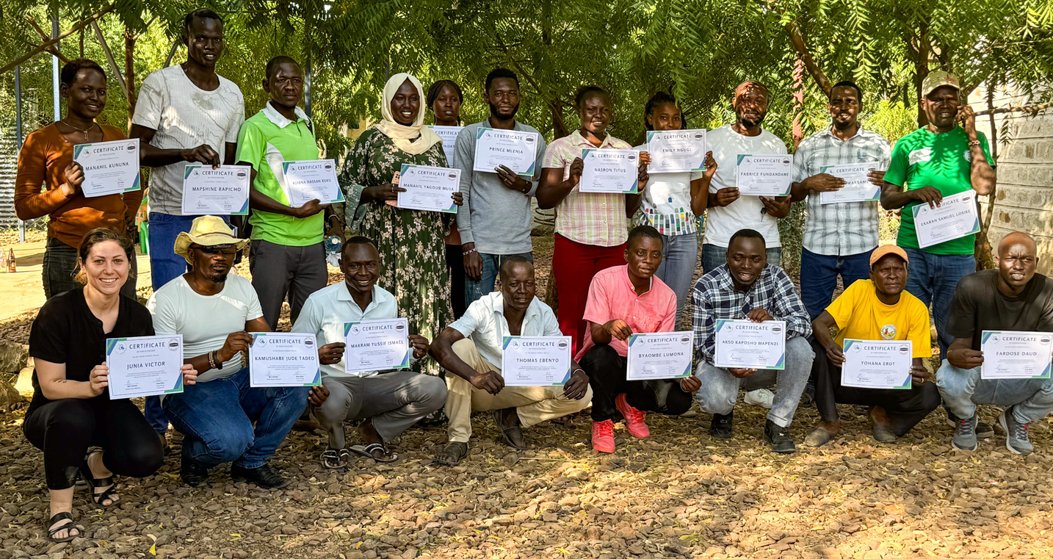

Conclusion
Refugee-led organizations have proven to be more efficient in several key areas compared to larger, international organizations, particularly in terms of cost-effectiveness, local knowledge, trust-building, and rapid response times. Their direct connection to the refugee communities they serve allows them to implement tailored solutions that are often more sustainable and impactful.
Key statistics highlight that RLOs can be up to 30-40% more cost-efficient, can mobilize relief faster, and allocate a larger percentage of their funding directly to beneficiaries. These factors make RLOs a valuable and efficient player in the refugee sector, especially when it comes to ensuring local ownership and sustainability in response efforts.
However, it’s important to note that RLOs still face significant barriers in terms of funding, capacity-building, and international recognition, which can limit their ability to scale their operations.

Slide 18


